Slide 1

11 JAN | 2021
Tiny (TEA) encryption & decryption
program
ECE311C-Microprocessor Course Project

Slide 2
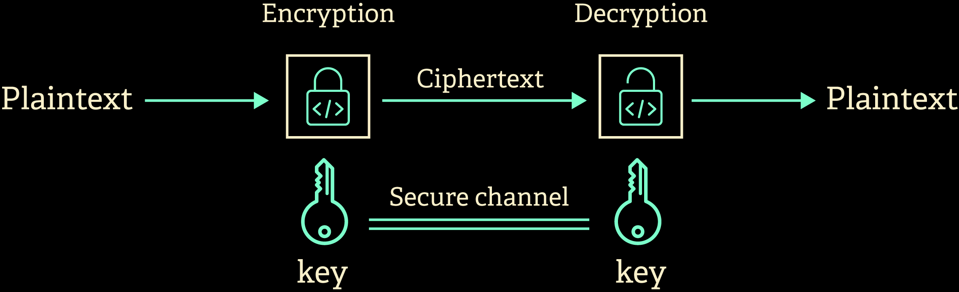
To establish secure communication, Transmitted data must be encrypted using cipher algorithms to prevent attacking it.
02

Slide 3
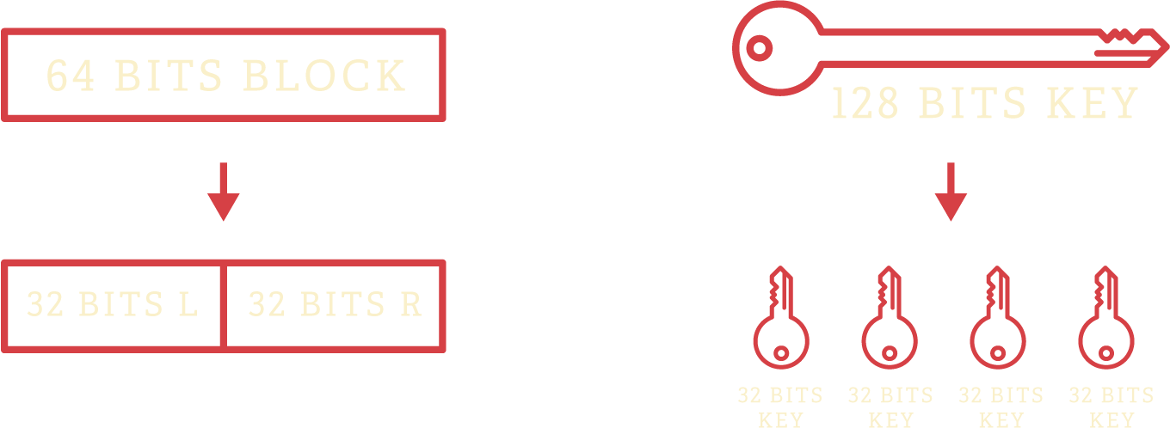
TEA - tiny encryption algorithm
Tiny Encryption Algorithm (TEA) is a block cipher was developed by David Wheeler and Roger Needham at the Computer Laboratory of Cambridge University and was first presented at the Fast Software Encryption workshop at Cambridge in 1994.
NUMBER OF ROUNDS = 32 ROUND
03

Slide 4
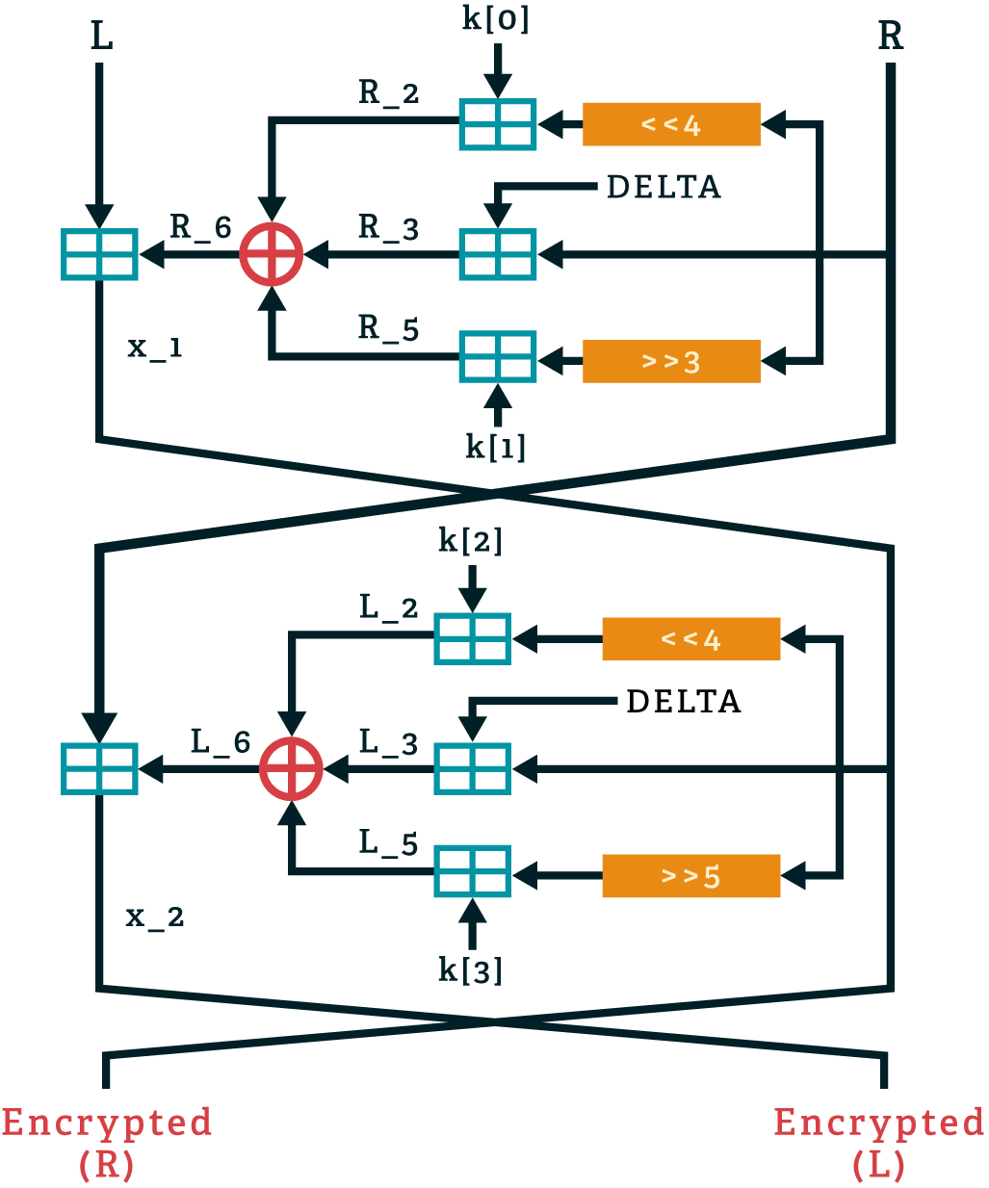
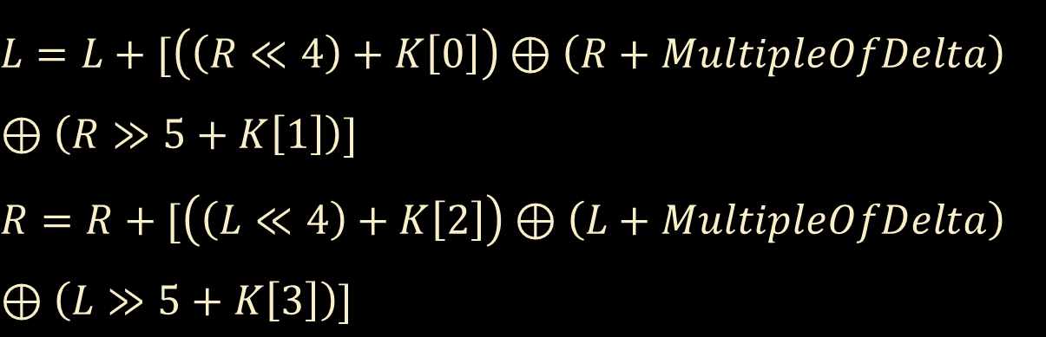
Encryption
ENCRYPTION ALGORITHM
$$L=L+[\left(\left(R≪4\right)+K\left[0\right]\right)⊕\left(R+MultipleOfDelta\right)$$
$$⊕\left(R≫5+K\left[1\right]\right)]$$
$$R=R+[\left(\left(L≪4\right)+K\left[2\right]\right)⊕\left(L+MultipleOfDelta\right)$$
$$⊕\left(L≫5+K\left[3\right]\right)]$$
Delta is a magic constant = 0x9e3779b9 simply serves to ensure that encryption in each round is different.
04

Slide 5
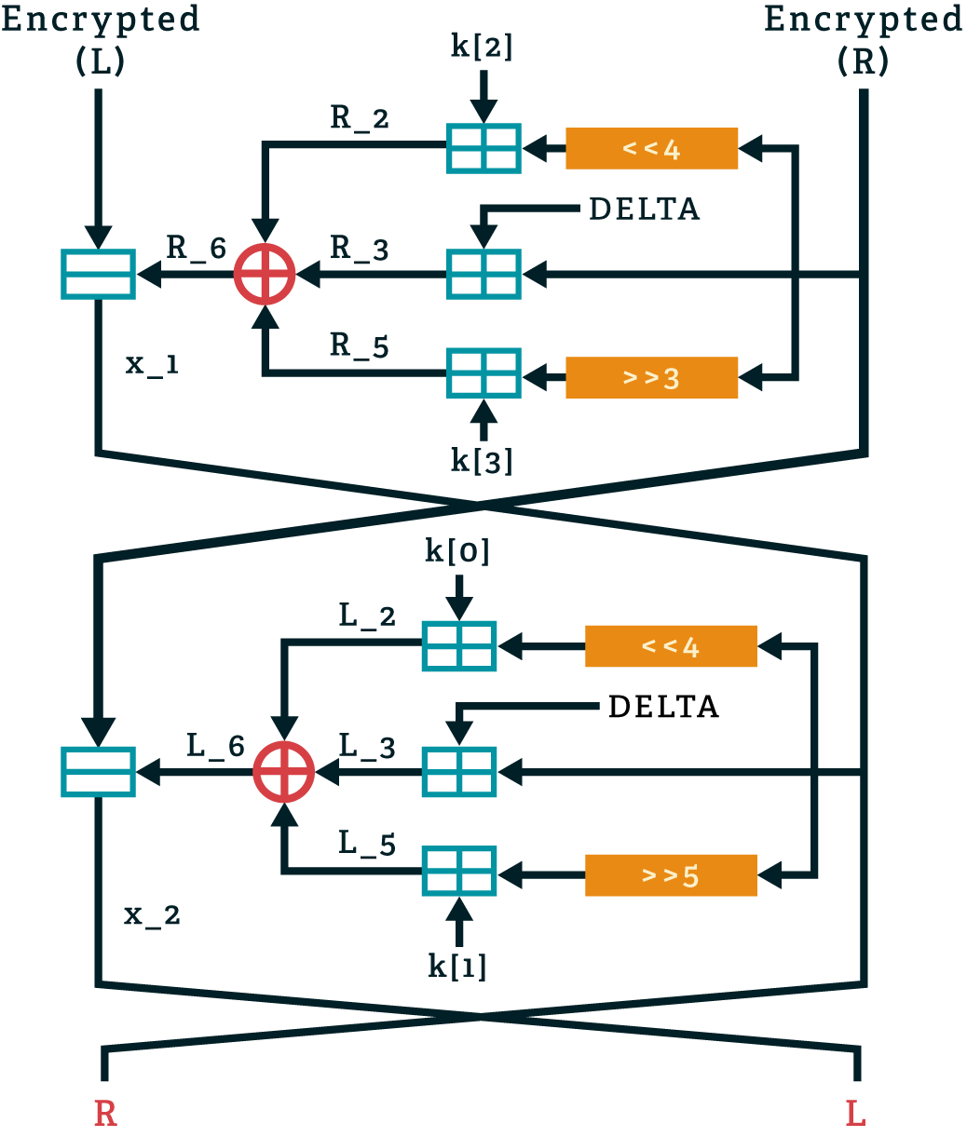
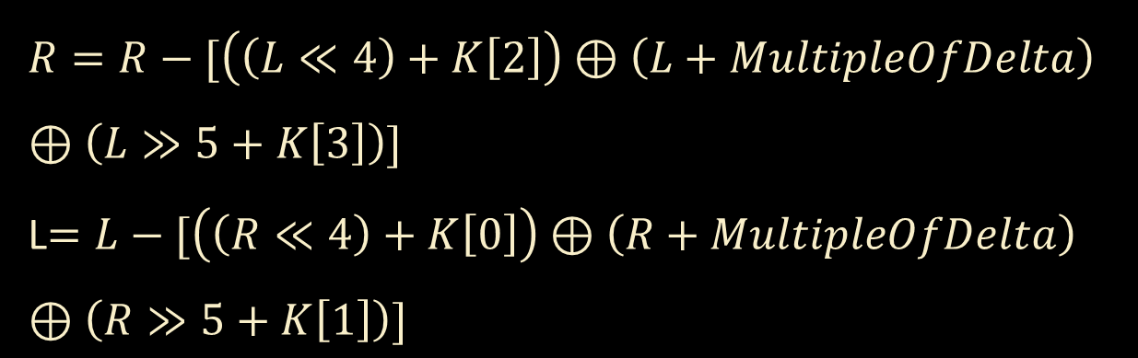
Decryption
DECRYPTION ALGORITHM
$$R=R−[\left(\left(L≪4\right)+K\left[2\right]\right)⊕\left(L+MultipleOfDelta\right)$$
$$⊕\left(L≫5+K\left[3\right]\right)]$$
L$=L−[\left(\left(R≪4\right)+K\left[0\right]\right)⊕\left(R+MultipleOfDelta\right)$
$$⊕\left(R≫5+K\left[1\right]\right)]$$
Delta is a magic constant = 0x9e3779b9 simply serves to ensure that encryption in each round is different.
05

Slide 6
Encrypt:
This function uses 128-bit key (4 separated keys of int) and returned array of int from combine function
It operates 32 rounds on unsigned integers and uses a 128-bit key, mixing all of the key material
in exactly the same way for each cycle
Different multiples of a magic constant are used
to prevent simple attacks ,The magic constant delta we used is 0x9E3779B9

Slide 7
Decrypt:
The same steps are repeated with reversed keys

